Slide 1
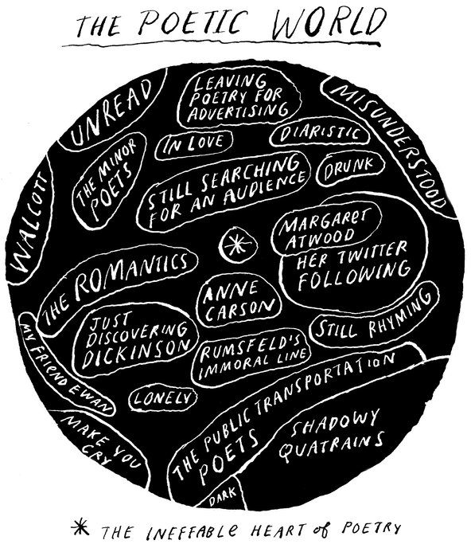
POetry
POETrY

Slide 2
What is Poetry?
1 minute class discussion

Slide 3
What Makes a Poem a Poem?
Watch (5minutes)
https://ed.ted.com/lessons/what-makes-a-poem-a-poem-melissa-kovacs
TEDTALK ED

Slide 4
Now What do you think of when I ask what is poetry?
Has your opinion changed? Why? Why not?
2 Minute Class Discussion

Slide 5
Under armor Ad Is this Poetry? Why?Why not?--Discuss
https://www.youtube.com/watch?v=IFigcXV05Vw
https://www.youtube.com/watch?v=3WFrHNYLApk
https://www.youtube.com/watch?v=3YVjaJhu8Vs

Slide 6
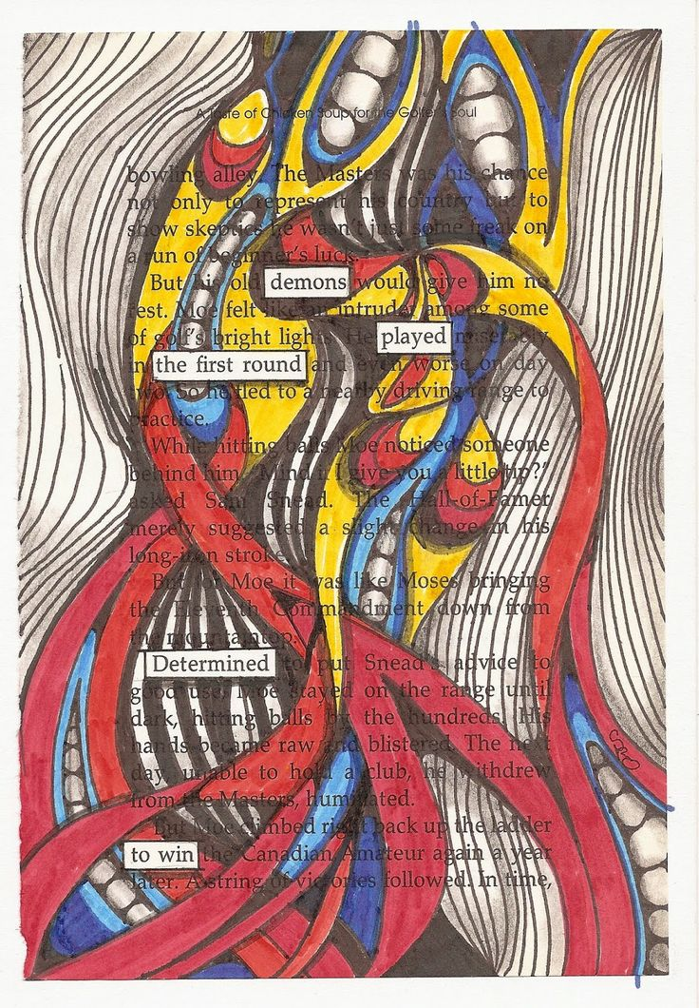
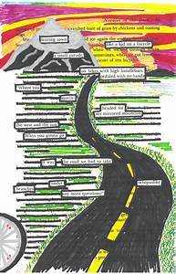
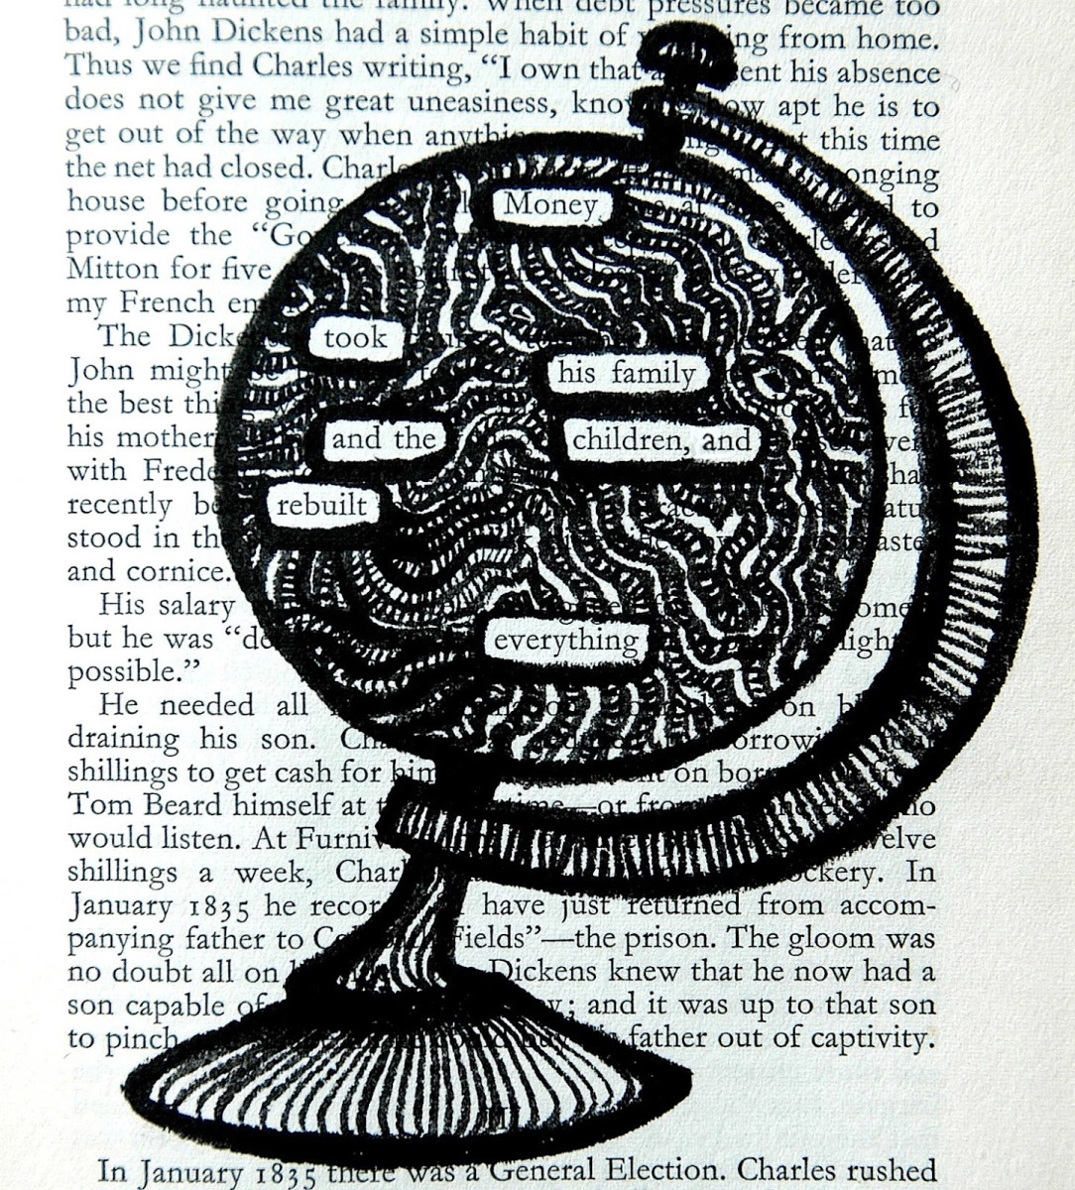
What is Blackout Poetry- Ariel's Blog Post-Youtube
Blackout Poetry
1 | 2 | 3 | 4 | Comments
Assignment does not convey an idea and or feeling | Assignment partially communicates an idea and or feeling. | Assignment communicates a feeling and idea | Assignment clearly communicates an idea and feeling
Text is unclear | Text presents a message but it is not clear | Text presents a clear message | Text presents a clear and thought provoking, message when read
Visually unappealing/no image evident | Some visual appeal/image unclear | Visually appealing imagery representing the message | Visually appealing, creative and artistic image related to the message.
Unorganized | Lacks organization | Organized | Well Organized
Notes:
https://www.youtube.com/watch?v=Nt5nguT3hEM

Slide 7
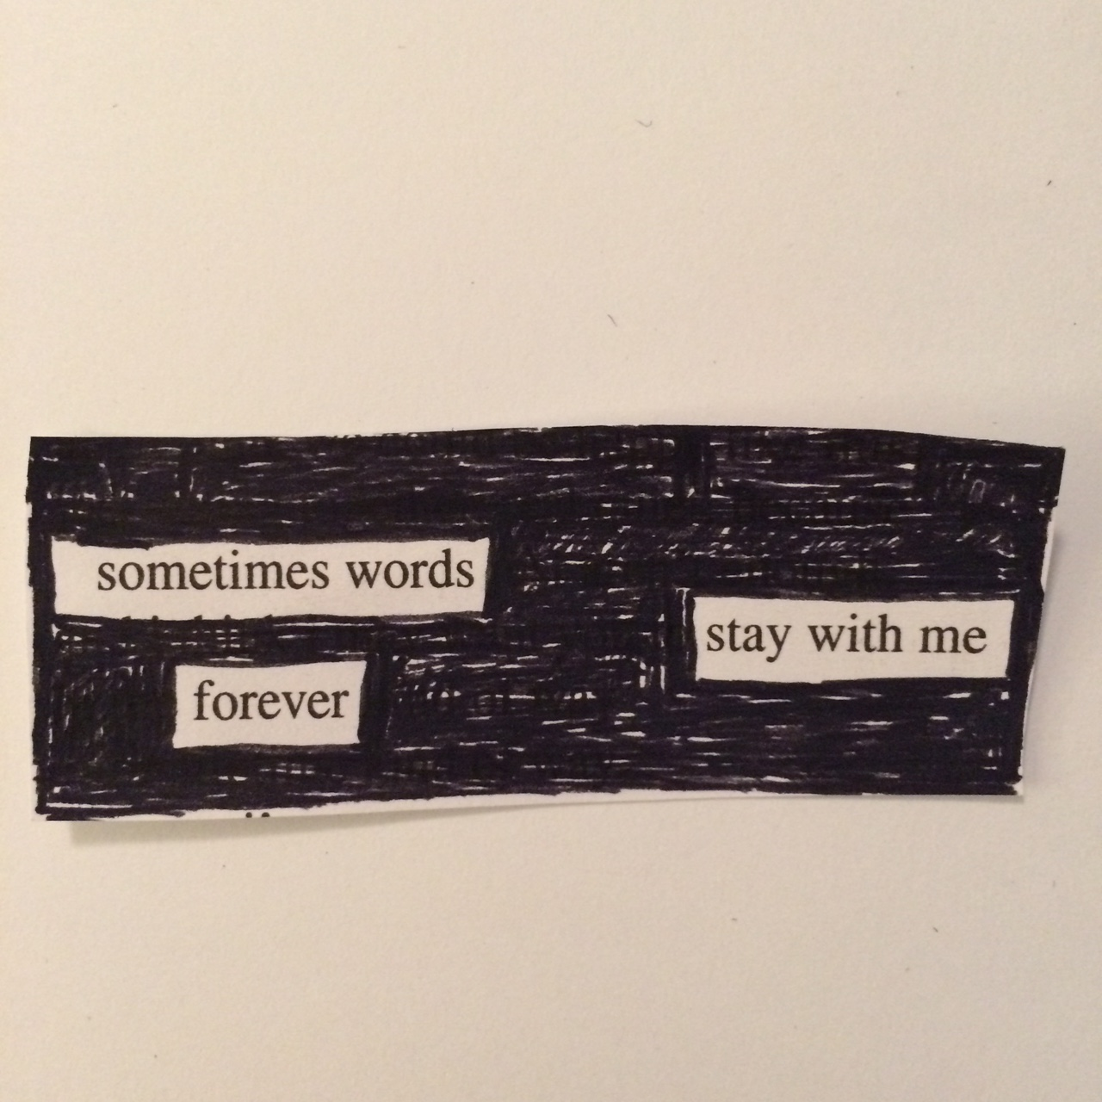
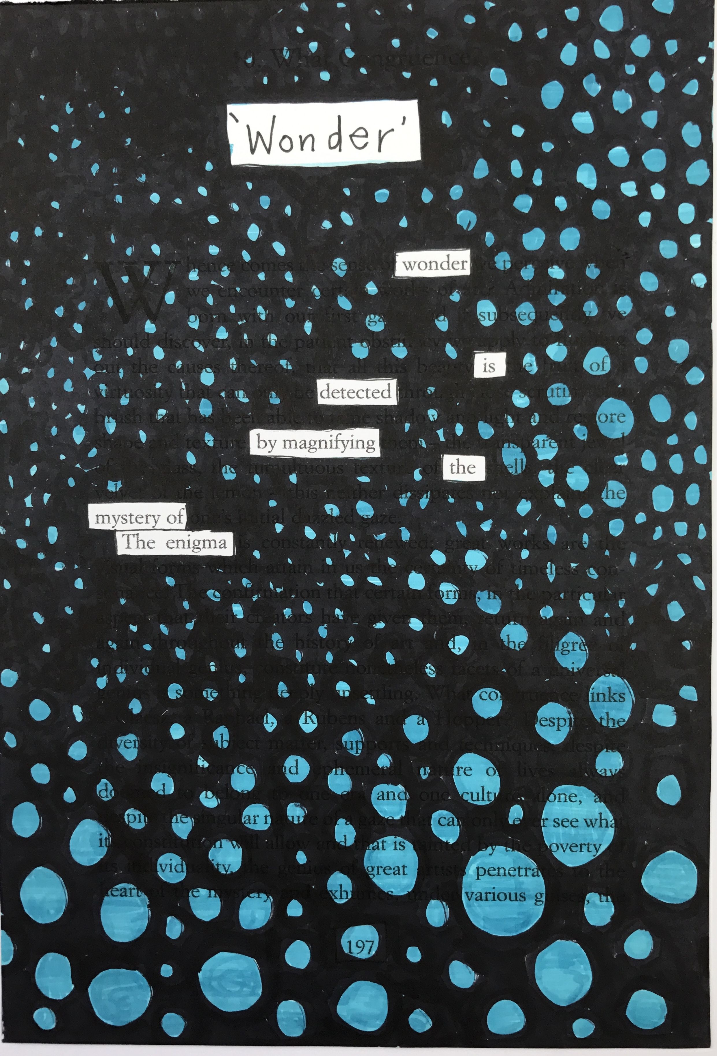

Slide 8
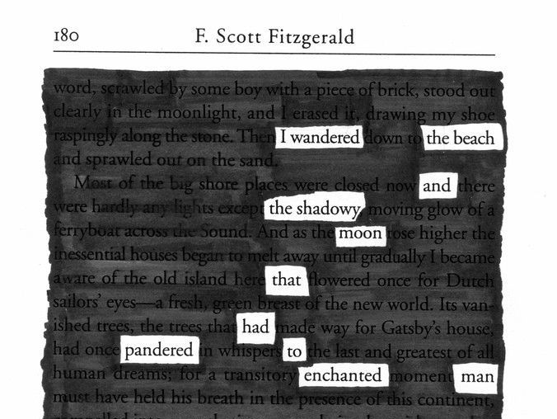

Slide 9
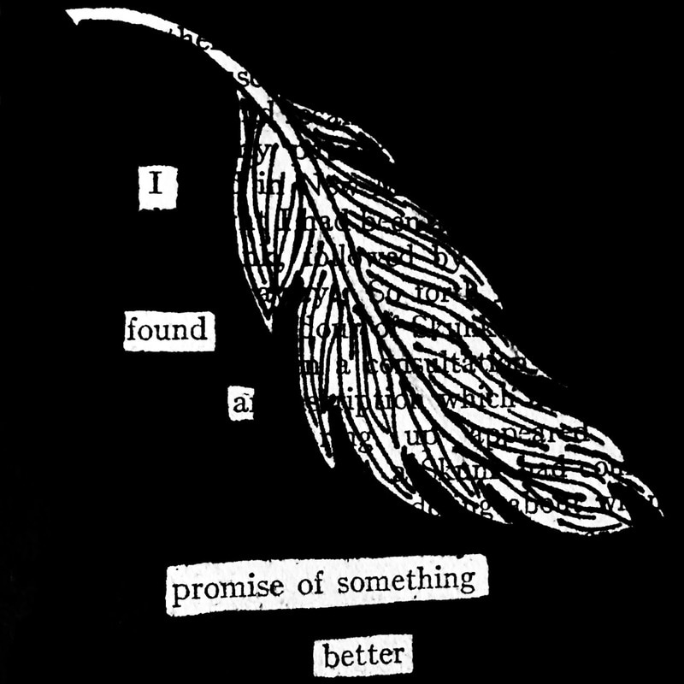

Slide 10
Figurative Language makes the poetry come to life
Notes:
Connect and review to Figurative Language Unit.

Slide 11
Poetry Techniques
Rhyme Chicka Chicka Boom Boom
Rhythm
Repetition Brown Bear Brown Bear
Notes:
Rhythm and Rhyme Poems with good rhythm, the way the words bounce off the tongue, are especially appealing to young children who are mastering language and reading. The best ones should almost seem like you`re singing them. Being able to rhyme is a very important milestone in early literacy development. Rhyme helps children understand that words that share common sounds often share common letter sequences. Rhyme also helps children break words into smaller parts and recognize smaller parts in words. Nursery rhymes are a great way to introduce rhyme. They can be spoken, sung or read aloud. Not only are nursery rhymes a pleasure to hear and to share, they provide a building block toward literacy.
Books with Rhythm Chicka Chicka Boom Boom? by Bill Martin Jr. Green Eggs and Ham by Dr. Suess I Went Walking by Sue Williams Books with Rhyme Brown Bear, Brown Bear, What Do You See? by Eric Carle Down by the Bay by Raffi Silly Sally by Audrey Wood
Repetition Repetition helps children make good guesses about what words will come next when you are reading with them or to them. Notice how your child’s reading confidence builds when the same great line keeps coming around again. This will help your child see himself as a reader. Repetition helps information “stick” in your child’s memory. Your child will remember what they read long after they have read it. Repetition makes poems memorable for your child and helps them understand what they are reading (the storyline). Books with Repetition The Napping House by Audrey Wood Does a Kangaroo Have a Mother, Too? by Eric Carle Is Your Mama a Llama? by Deborah Guarino

Slide 12
Activity
Snowball Poetry
Write a line to start a poem. Be mindful that this poem will have to rhyme.
Crumple the paper LIGHTY into a “snowball”
When Mrs. Perez yells “snow ball”, toss the “snowball” into the air.
Pick up a “snowball”, read it and continue to write another line that rhymes and contributes appropriately to the poem.
Repeat x5
Notes:
This is fun.
Remind students before of appropriate behaviours and how to conduct themselves while moving around the classroom. Stress the importance of following the directions.

Slide 13
Spoken word poetry
https://www.youtube.com/watch?v=D-eVF_G_p-Y I will not let test scores determine my fate
https://www.youtube.com/watch?v=zaSIx1xO7CE On being creative
https://www.youtube.com/watch?v=-O7v4EJjx-g What students need to hear

Slide 14
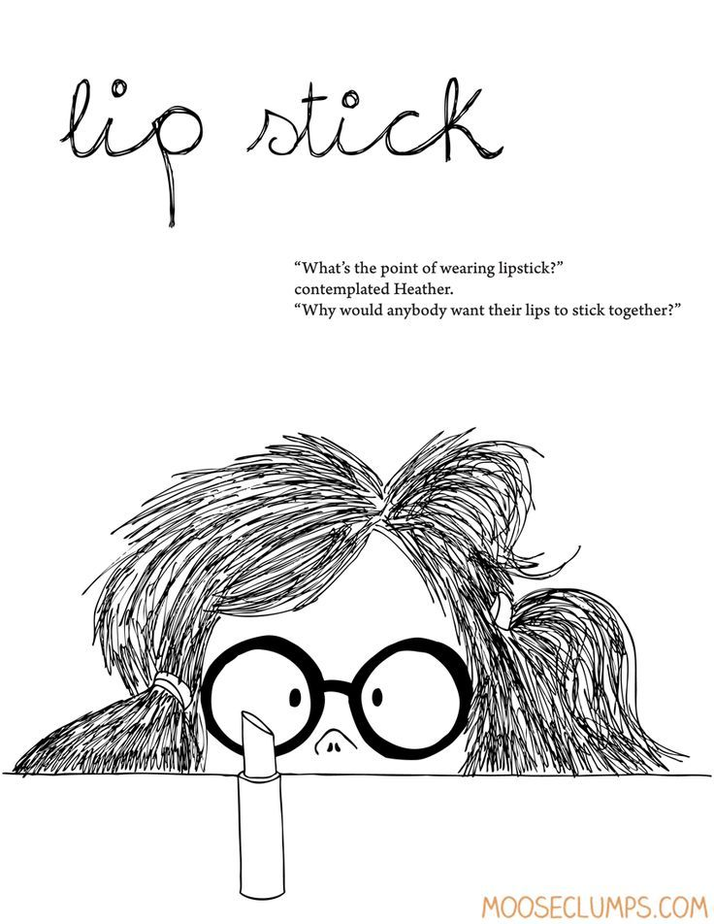
Childrens POems
Cat
BY MARILYN SINGER
I prefer
warm fur,
a perfect fire
to lie beside,
a cozy lap
where I can nap,
an empty chair
when she's not there.
I want heat
on my feet
on my nose
on my hide.
No cat I remember
dislikes December
inside.

Slide 15
Be Glad Your Nose Is on Your Face
Be glad your nose is on your face, not pasted on some other place,
for if it were where it is not, you might dislike your nose a lot.
Imagine if your precious nose were sandwiched in between your toes, that clearly would not be a treat, for you’d be forced to smell your feet.
Your nose would be a source of dread were it attached atop your head, it soon would drive you to despair, forever tickled by your hair.
Within your ear, your nose would be an absolute catastrophe, for when you were obliged to sneeze, your brain would rattle from the breeze.
Your nose, instead, through thick and thin, remains between your eyes and chin, not pasted on some other place-- be glad your nose is on your face!

Slide 16
Sick Shel Silverstein, 1930 - 1999
“I cannot go to school today," Said little Peggy Ann McKay.
“I have the measles and the mumps, A gash, a rash and purple bumps.
My mouth is wet, my throat is dry, I’m going blind in my right eye. My tonsils are as big as rocks,
I’ve counted sixteen chicken pox And there’s one more—that’s seventeen,
And don’t you think my face looks green?
My leg is cut—my eyes are blue— It might be instamatic flu.
I cough and sneeze and gasp and choke, I’m sure that my left leg is broke— My hip hurts when I move my chin,
My belly button’s caving in, My back is wrenched, my ankle’s sprained, My ‘pendix pains each time it rains.
My nose is cold, my toes are numb. I have a sliver in my thumb. My neck is stiff, my voice is weak, I hardly whisper when I speak.
My tongue is filling up my mouth, I think my hair is falling out.
My elbow’s bent, my spine ain’t straight, My temperature is one-o-eight
. My brain is shrunk, I cannot hear, There is a hole inside my ear. I have a hangnail, and my heart is—what?
What’s that? What’s that you say? You say today is. . .Saturday? G’bye, I’m going out to play!”

Slide 17
My Doggy Ate My Essay
BY DARREN SARDELLI
My doggy ate my essay.
He picked up all my mail.
He cleaned my dirty closet
and dusted with his tail.
He straightened out my posters
and swept my wooden floor.
My parents almost fainted
when he fixed my bedroom door.
I did not try to stop him.
He made my windows shine.
My room looked like a palace,
and my dresser smelled like pine.
He fluffed up every pillow.
He folded all my clothes.
He even cleaned my fish tank
with a toothbrush and a hose.
I thought it was amazing
to see him use a broom.
I’m glad he ate my essay
on “How to Clean My Room.”

Slide 18
Invitation –Shel silvertstein
https://www.youtube.com/watch?v=IrHX_UNSuc8

Slide 19
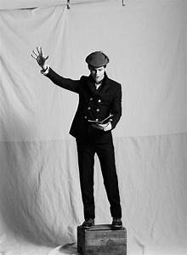
What is your favourite poem?
Groups of 2-3 (1 Ipad)
Search your favourite childrens poem
Recite your poem in your group—you can have different individuals read or different people of the group say different lines.
Final performance
Notes:
Reciting Poetry
Activity
(10-15 Minutes)

Slide 20
HaiKu
What is a Haiku?
A traditional form of Japanese poetry. Haiku poems consist of 3 lines. The first and last lines of a Haiku have 5 syllables and the middle line has 7 syllables. The lines rarely rhyme.
What are syllables ?
A syllable is a part of a word pronounced as a unit. It is usually made up of a vowel alone or a vowel with one or more consonants.
A good way to remember:
I am first with five Then seven in the middle -- Five again to end.
Notes:
Begin by projecting one of the traditional haikus on the board. Read the haiku together.
Ask students questions about the traditional format of a haiku. Cover the following areas:
Number of syllables per line (5-7-5 pattern)
Number of lines (three lines)
Typical nature theme
Ask students to circle on the board the descriptive words they find in the haiku.
Show the image(s) you found for the haiku and reread the haiku. Discuss the following about the image:
How does this image fit the descriptive language of the haiku?
What emotions does the image invoke?
Do these emotions fit the mood of the haiku?

Slide 21
Spring is in the Air by Kaitlyn Guenther Spring is in the air Flowers are blooming sky high Children are laughing

Slide 23
Activity: Outside Haiku
Groups of 4 ( 1 Ipad)
We will take a walk…listen to the sounds, see and hear all the thing, touch, and experience nature.
Take photos
Write things down
Experience everything
ENJOY
GOAL: Document your experience outdoors, collaborate as a group, team work, create a Haiku to represent your experience with Nature, use photography techniques to represent your experience.

Slide 24
Slam Poetry

Slide 25
Narrative POetry

Slide 26
Metaphor Dice

